Slide 1

DATA STRUCTURES AND ALGORITHMS (113215)
Dr. Owais Hussain

Slide 2

Agenda
Binary Heap
Heap Sort
Heapify
Priority Queues
Hashing
Handling Collisions
Hash Table

Slide 3
Sample 2
Binary Heap
Binary Heap is a Binary Tree which is:
ALWAYS complete.
Each Parent node is either the smallest or the largest element.
In Min heap, the element at root node is the smallest and each parent node is smaller than all its children.
In Max heap, the element at root node is the largest and each parent node is larger than all its children.
One of the most important uses of Heap is in implementing Priority Queues.

Slide 4
Sample 2
Binary Heap
In Min heap, the element at root node is the smallest and each parent node is smaller than all its children.
Assume the data to be: 4967, 4910, 5144, 5073, 4930, 5040, 4901, 5019, 5139, 4669, 4946
Th Min Heap will be like the first tree.
Max Heap will look like the second tree.
4669
4901
4930
5073
4967
4910
4946
5040
5019
5139
5144
4967
4910
5144
5139
4946
5040
4901
5073
5019
4669
4930

Slide 5
Sample 2
Binary Heap
INSERT operation in Max heap:
If the heap is empty, then Insert the element at the root.
Otherwise:
Insert the element at the last free space in complete binary tree.
If the element is greater than its parent, then swap with the parent.
Keep on repeating until the inserted element is the larger than its parent element.
The time complexity of INSERT operation is based on the number of SWAP operations.

Slide 6
Sample 2
Binary Heap
INSERT 5150 in the following Heap
4967
4910
5144
5139
4946
5040
4901
5073
5019
4669
4930
5150
4967
4910
5144
5139
4946
5040
4901
5073
5019
4669
4930
5150
4967
4910
5144
5139
4946
5150
4901
5073
5019
4669
4930
5040
4967
4910
5150
5139
4946
5144
4901
5073
5019
4669
4930
5040

Slide 7
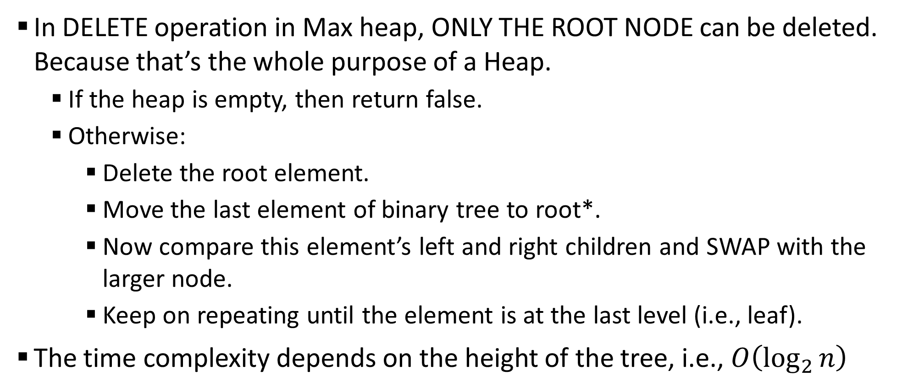
Sample 2
Binary Heap
In DELETE operation in Max heap, ONLY THE ROOT NODE can be deleted. Because that’s the whole purpose of a Heap.
If the heap is empty, then return false.
Otherwise:
Delete the root element.
Move the last element of binary tree to root*.
Now compare this element’s left and right children and SWAP with the larger node.
Keep on repeating until the element is at the last level (i.e., leaf).
The time complexity depends on the height of the tree, i.e., $O\left(\log_{2}{n}\right)$
Notes:
In delete operation, the last element is chosen to be moved to maintain completeness property.

Slide 8
Sample 2
Binary Heap
DELETE 5150 from the following Heap
4967
4910
5150
5139
4946
5144
4901
5073
5019
4669
4930
5040
4967
4910
5139
4946
5040
5073
5019
4669
4930
5150
4901
4967
5139
4910
4946
5040
5073
5019
4669
4930
5150
4901
4967
5139
5073
4946
5040
4910
5019
4669
4930
5150
4901
Can you guess the last step?

Slide 9
Sample 2
Heap Sort
Heap Sort is one of the most efficient sorting algorithms.
Once we implement a Heap, then this algorithm is fairly simple with only 2 steps.
Given an array of unsorted values:
INSERT all values in Min Heap.
DELETE all values from the Heap and collect into a linear array.
The array will be sorted.
Similarly, to sort an array into reverse order, use Max Heap.

Slide 10
Sample 2
Heap Sort
Let’s sort Array: 5144, 4967, 4910, 5073, 5040, 5019, 4669 in descending order using Max Heap.
5144
5144
4967
5144
4967
4910
5144
5073
4910
4967
5144
5073
5040
4910
4967
5144
5073
5040
5019
4967
4669
4910

Slide 11
Sample 2
Heap Sort
Repeat DELETE operation until the Heap is empty.
5144
5073
5040
5019
4967
4669
4910
5073
5040
4669
5019
4967
4910
5040
4967
4669
5019
4910
5019
4967
4669
4910
4967
4910
4669
4910
4669
Notes:
Focus on the 6th delete operation. The value 4669 was moved towards left because it followed the algorithm. This is very important to note.

Slide 12
Sample 2
Heap Sort
As the Heap is being emptied, collect the deleted elements in another Array.
4910
4669
4669
Eventually, the items will be collected in descending order.
5144
5073
5040
5019
4967
4910
4669

Slide 13
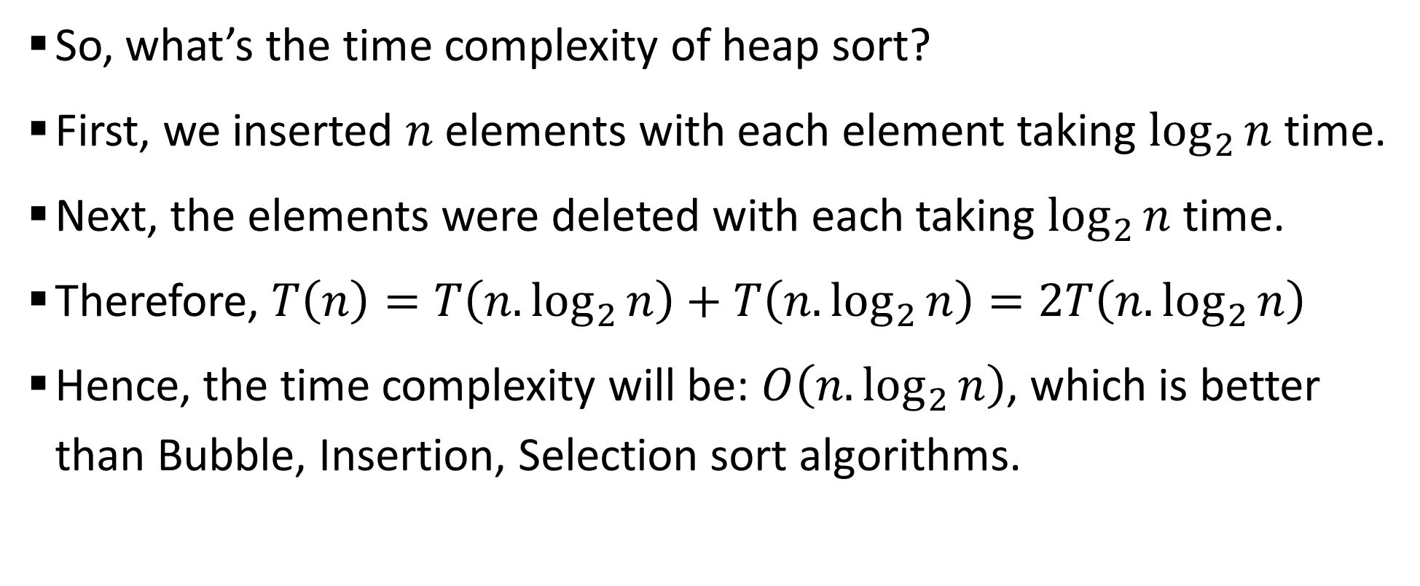
Sample 2
Heap Sort
So, what’s the time complexity of heap sort?
First, we inserted $n$ elements with each element taking $\log_{2}{n}$ time.
Next, the elements were deleted with each taking $\log_{2}{n}$ time.
Therefore, $T\left(n\right)=T\left(n.\log_{2}{n}\right)+T\left(n.\log_{2}{n}\right)=2T\left(n.\log_{2}{n}\right)$
Hence, the time complexity will be: $O\left(n.\log_{2}{n}\right)$, which is better than Bubble, Insertion, Selection sort algorithms.

Slide 14
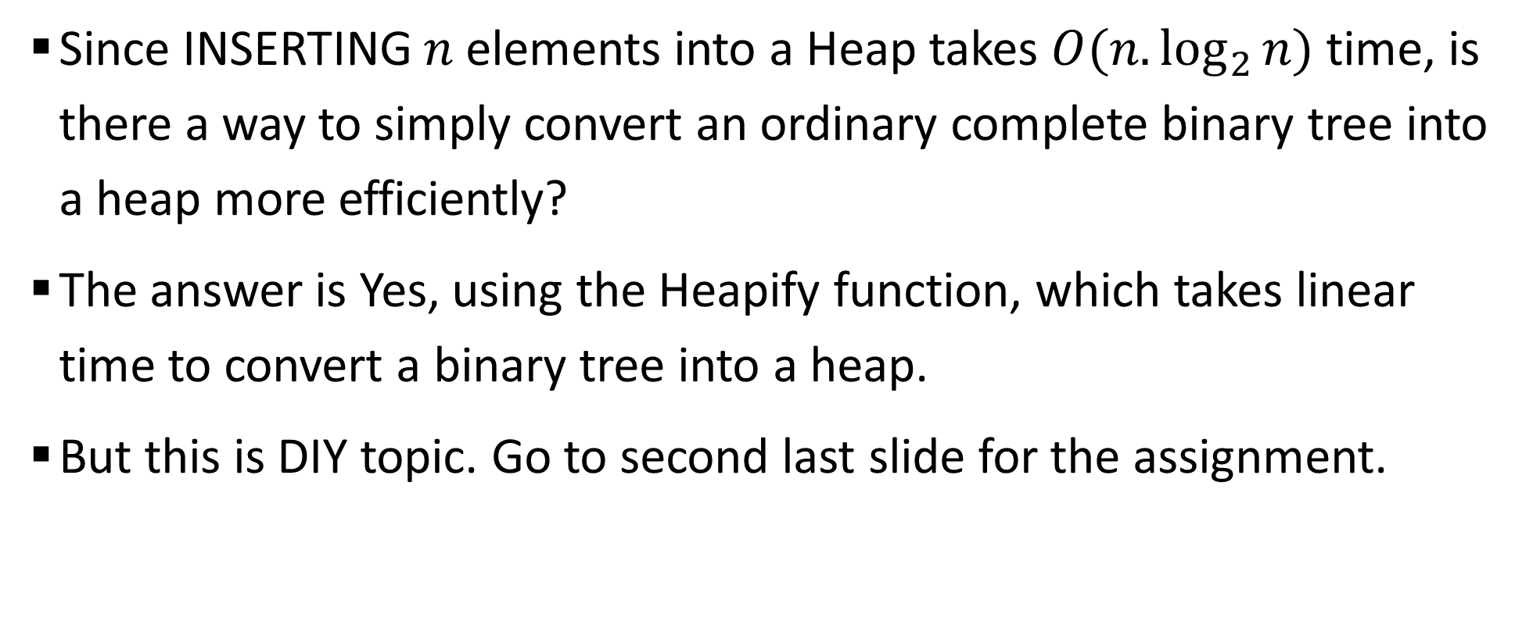
Sample 2
Heapify
Since INSERTING $n$ elements into a Heap takes $O(n.\log_{2}{n})$ time, is there a way to simply convert an ordinary complete binary tree into a heap more efficiently?
The answer is Yes, using the Heapify function, which takes linear time to convert a binary tree into a heap.
But this is DIY topic. Go to second last slide for the assignment.

Slide 15
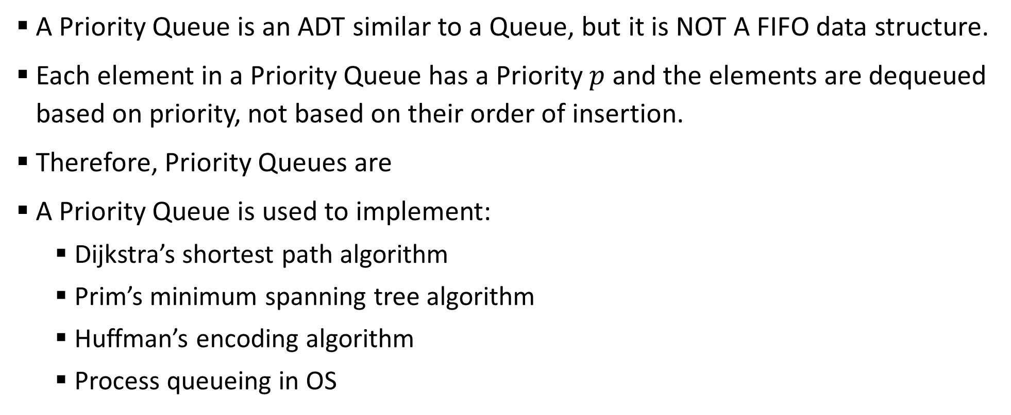
Sample 2
Priority Queues
A Priority Queue is an ADT similar to a Queue, but it is NOT A FIFO data structure.
Each element in a Priority Queue has a Priority $p$ and the elements are dequeued based on priority, not based on their order of insertion.
Therefore, Priority Queues are
A Priority Queue is used to implement:
Dijkstra’s shortest path algorithm
Prim’s minimum spanning tree algorithm
Huffman’s encoding algorithm
Process queueing in OS

Slide 16
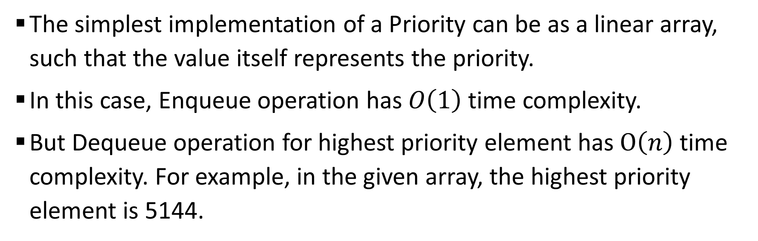
Sample 2
Priority Queues
The simplest implementation of a Priority can be as a linear array, such that the value itself represents the priority.
In this case, Enqueue operation has $O\left(1\right)$ time complexity.
But Dequeue operation for highest priority element has $O\left(n\right)$ time complexity. For example, in the given array, the highest priority element is 5144.
4669
5051
5073
5144
3826
4910

Slide 17
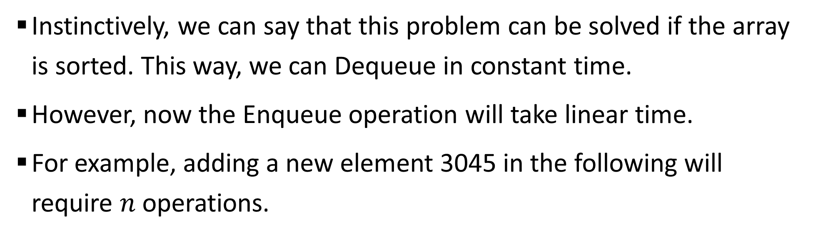
Sample 2
Priority Queues
Instinctively, we can say that this problem can be solved if the array is sorted. This way, we can Dequeue in constant time.
However, now the Enqueue operation will take linear time.
For example, adding a new element 3045 in the following will require $n$ operations.
3826
4669
4910
5051
5073
5144

Slide 18
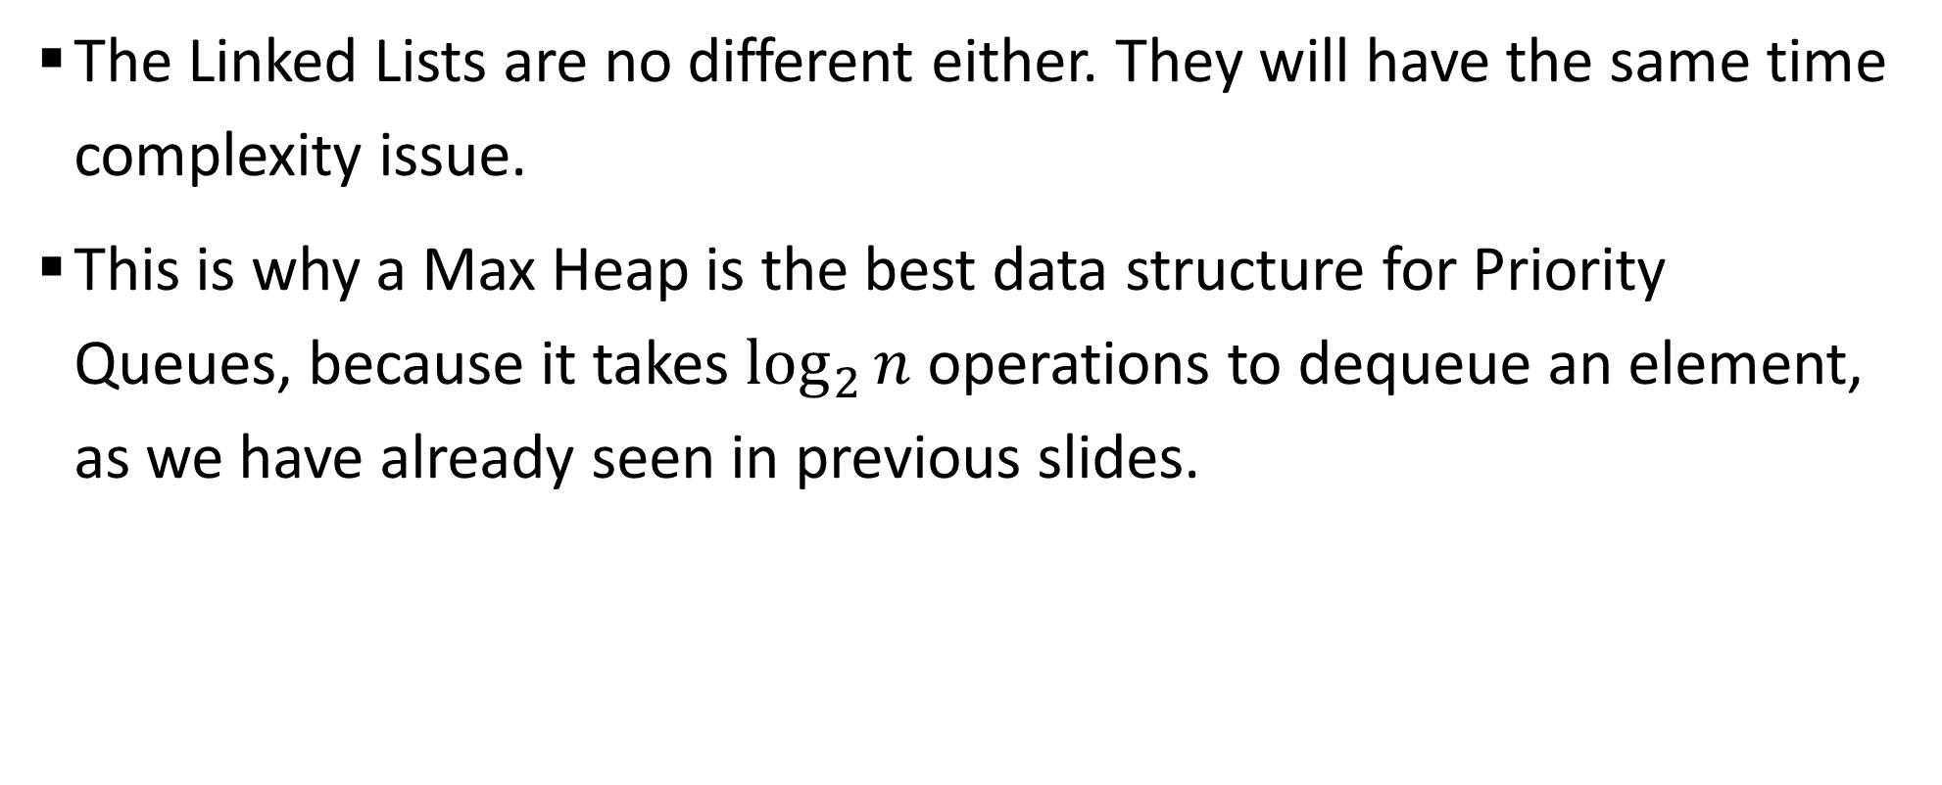
Sample 2
Priority Queues
The Linked Lists are no different either. They will have the same time complexity issue.
This is why a Max Heap is the best data structure for Priority Queues, because it takes $\log_{2}{n}$ operations to dequeue an element, as we have already seen in previous slides.

Slide 19
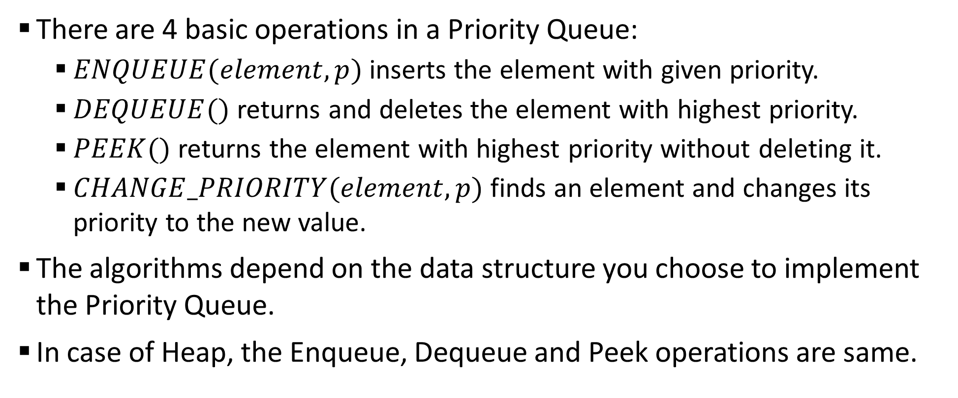
Sample 2
Priority Queues
There are 4 basic operations in a Priority Queue:
$ENQUEUE(element, p)$ inserts the element with given priority.
$DEQUEUE()$ returns and deletes the element with highest priority.
$PEEK()$ returns the element with highest priority without deleting it.
$CHANGE_PRIORITY(element, p)$ finds an element and changes its priority to the new value.
The algorithms depend on the data structure you choose to implement the Priority Queue.
In case of Heap, the Enqueue, Dequeue and Peek operations are same.

Slide 20
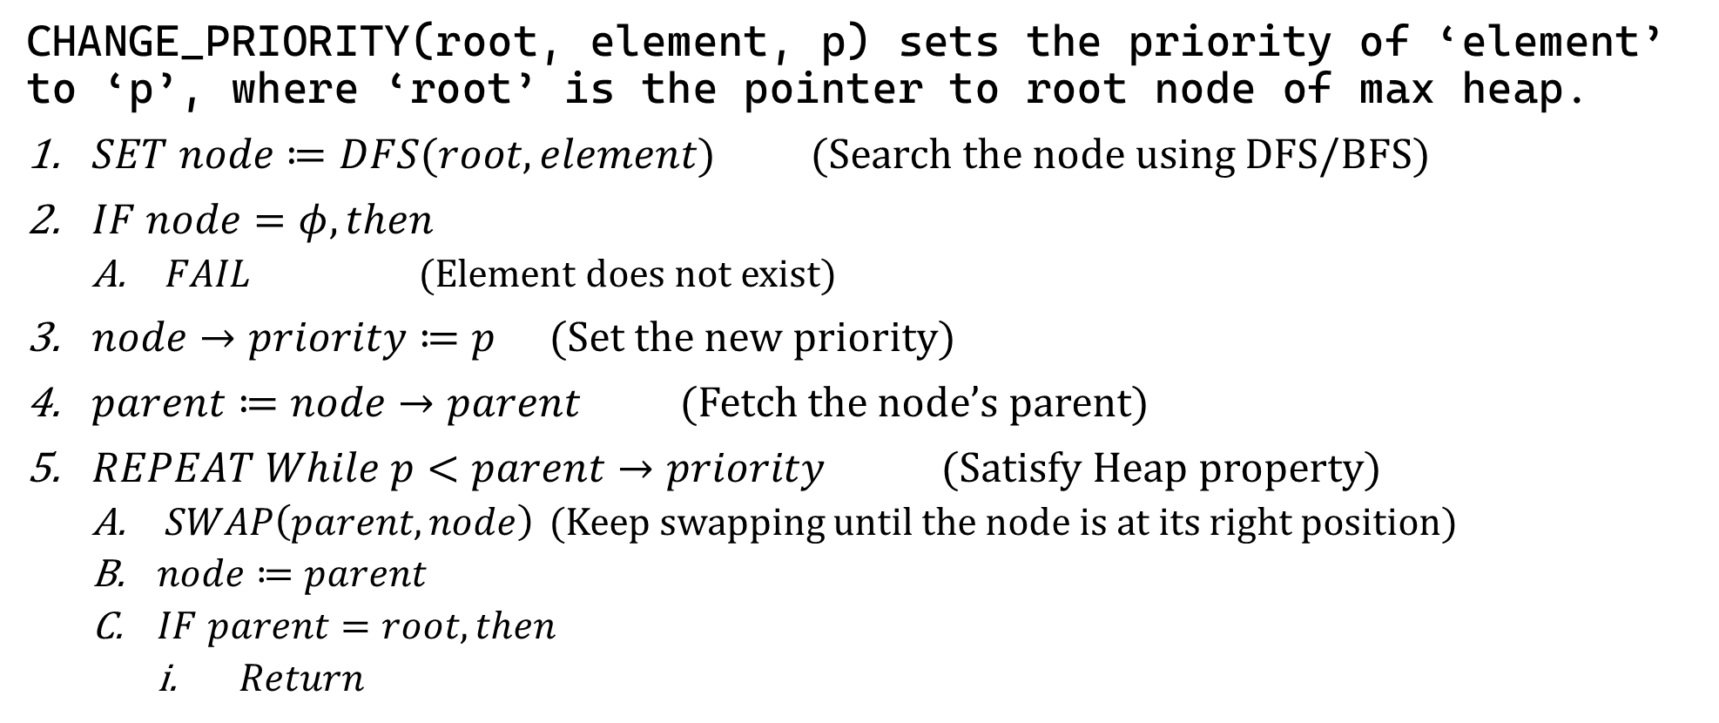
Sample 2
Priority Queues
CHANGE_PRIORITY(root, element, p) sets the priority of ‘element’ to ‘p’, where ‘root’ is the pointer to root node of max heap.
$SET node≔DFS(root, element)$ (Search the node using DFS/BFS)
$IF node=φ, then$
$FAIL$ (Element does not exist)
$node→priority≔p$ (Set the new priority)
$parent≔node→parent$ (Fetch the node’s parent)
$REPEAT While p<parent→priority$ (Satisfy Heap property)
$SWAP\left(parent,node\right)$ (Keep swapping until the node is at its right position)
$node≔parent$
$IF parent=root, then$
$Return$

Slide 21
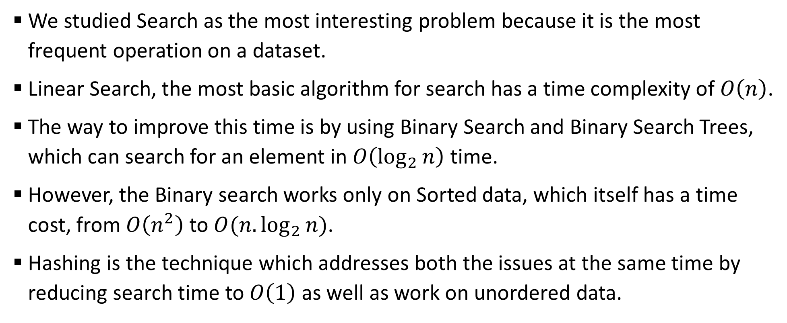
Sample 2
Hashing
We studied Search as the most interesting problem because it is the most frequent operation on a dataset.
Linear Search, the most basic algorithm for search has a time complexity of $O\left(n\right)$.
The way to improve this time is by using Binary Search and Binary Search Trees, which can search for an element in $O\left(\log_{2}{n}\right)$ time.
However, the Binary search works only on Sorted data, which itself has a time cost, from $O\left(n^{2}\right)$ to $O(n.\log_{2}{n})$.
Hashing is the technique which addresses both the issues at the same time by reducing search time to $O\left(1\right)$ as well as work on unordered data.

Slide 22
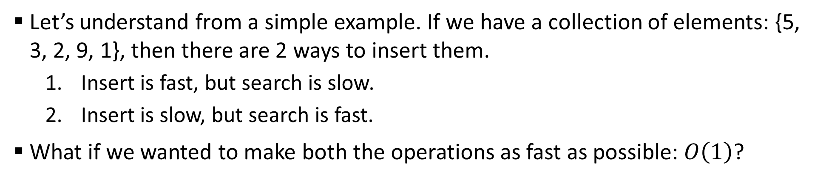
Sample 2
Hashing
Let’s understand from a simple example. If we have a collection of elements: {5, 3, 2, 9, 1}, then there are 2 ways to insert them.
Insert is fast, but search is slow.
Insert is slow, but search is fast.
What if we wanted to make both the operations as fast as possible: $O\left(1\right)$?
5
3
2
9
1
1
2
3
5
9
Let’s put each element to the index determined by its value. The search will be $O\left(1\right)$ as we only need to check whether there’s a value on the given index or not.
1
2
3
5
9

Slide 23
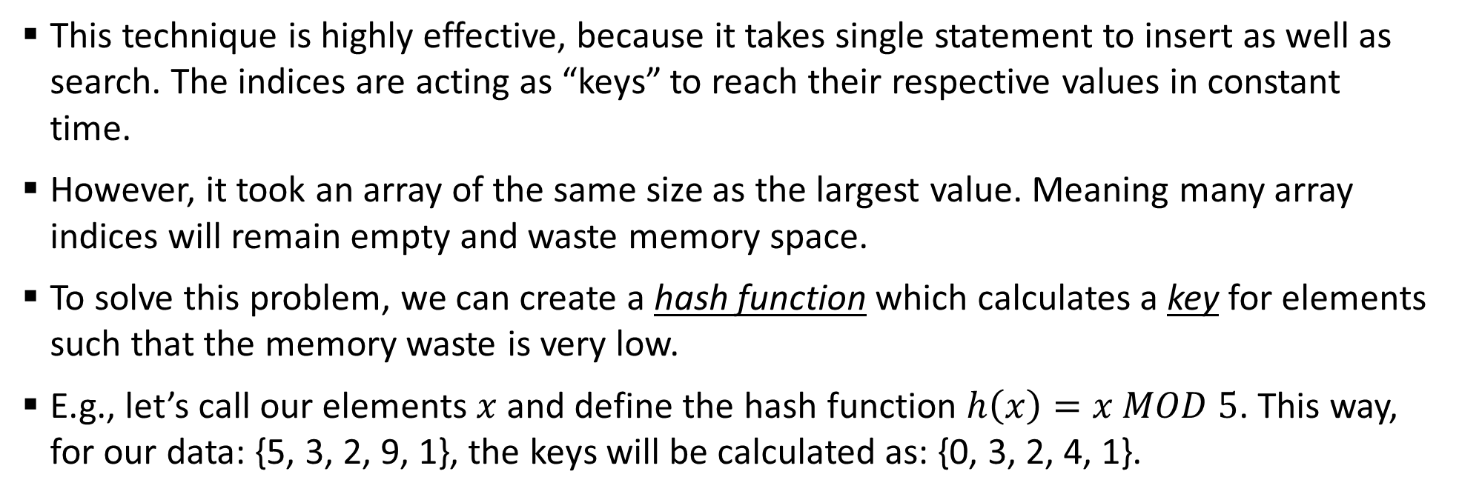
Sample 2
Hashing
This technique is highly effective, because it takes single statement to insert as well as search. The indices are acting as “keys” to reach their respective values in constant time.
However, it took an array of the same size as the largest value. Meaning many array indices will remain empty and waste memory space.
To solve this problem, we can create a hash function which calculates a key for elements such that the memory waste is very low.
E.g., let’s call our elements $x$ and define the hash function $h\left(x\right)=x MOD 5$. This way, for our data: {5, 3, 2, 9, 1}, the keys will be calculated as: {0, 3, 2, 4, 1}.
5
1
2
3
9
Notes:
We can have any hash function. For example, a hash function for SID could be $ABS(50000 – SID) \% 50$

Slide 24
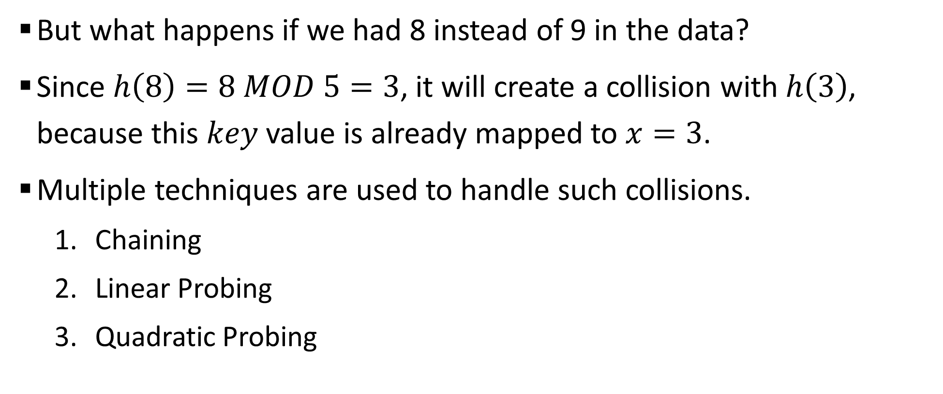
Sample 2
Handling Collisions
But what happens if we had 8 instead of 9 in the data?
Since $h\left(8\right)=8 MOD 5=3$, it will create a collision with $h\left(3\right)$, because this $key$ value is already mapped to $x=3$.
Multiple techniques are used to handle such collisions.
Chaining
Linear Probing
Quadratic Probing

Slide 25
Sample 2
Handling Collisions
Chaining is an open-hashing technique of collision handling in which instead of a single element, we attach a linked list to each index of the array.
There is a little overhead in this case, because now instead of 1 steps, we may require more steps, but the efficiency will still be much faster.
Chaining is an effective technique, but it converts our data structure into dynamic.
To handle collision and keep the data structure static, we use close-hashing techniques like Linear and Quadratic Probing.
0
5
Next: Null
1
1
Next: Null
2
2
Next: Null
3
3
8
Next: 202
Next: Null
4

Slide 26
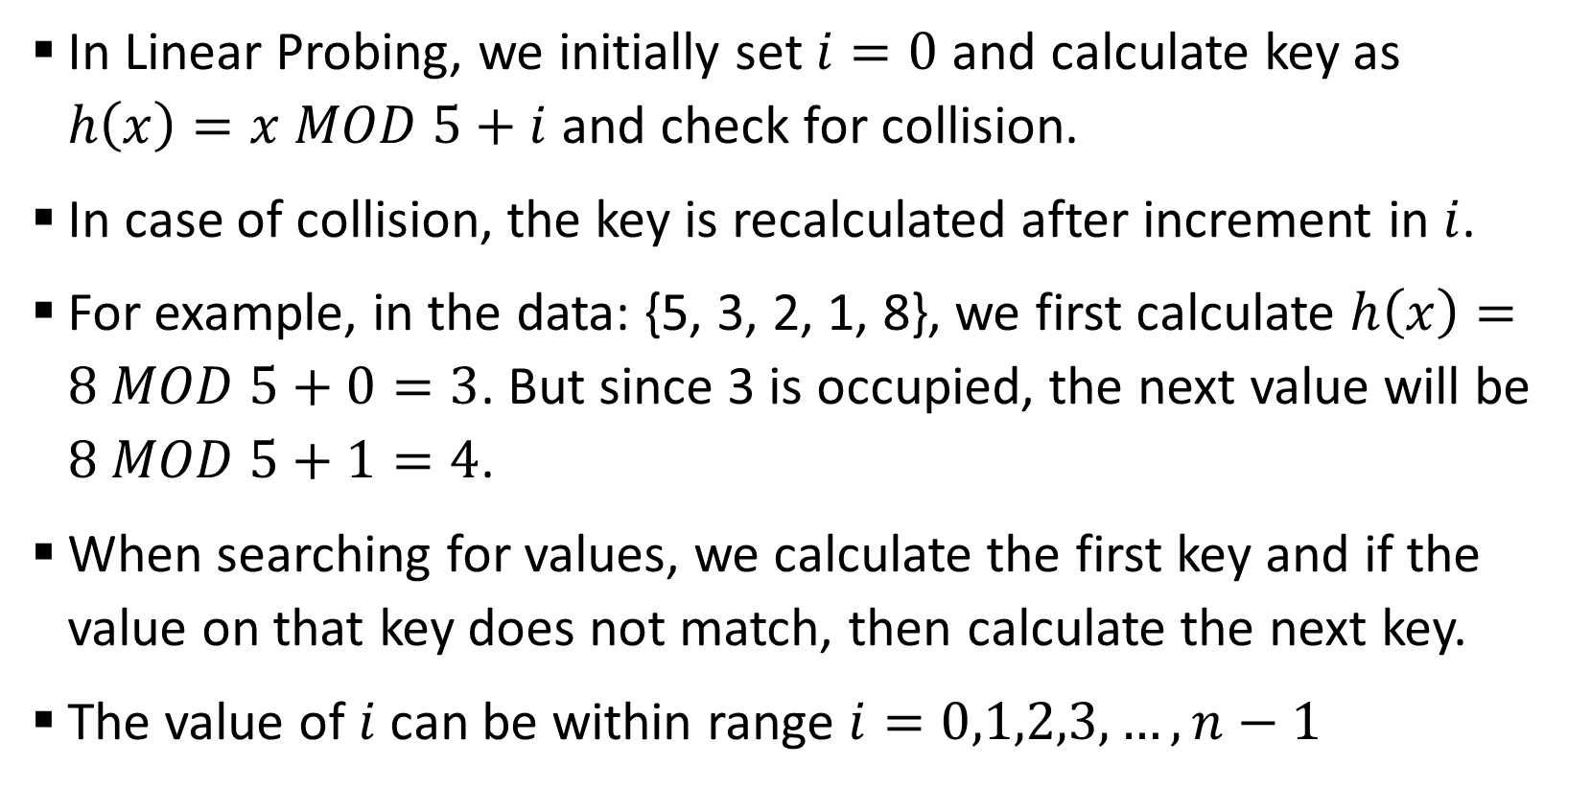
Sample 2
Handling Collisions
In Linear Probing, we initially set $i=0$ and calculate key as $h\left(x\right)=x MOD 5+i$ and check for collision.
In case of collision, the key is recalculated after increment in $i$.
For example, in the data: {5, 3, 2, 1, 8}, we first calculate $h\left(x\right)=8 MOD 5+0=3$. But since 3 is occupied, the next value will be $8 MOD 5+1=4$.
When searching for values, we calculate the first key and if the value on that key does not match, then calculate the next key.
The value of $i$ can be within range $i=0,1,2,3,…,n−1$
0
5
1
1
2
2
3
3
4
8

Slide 27
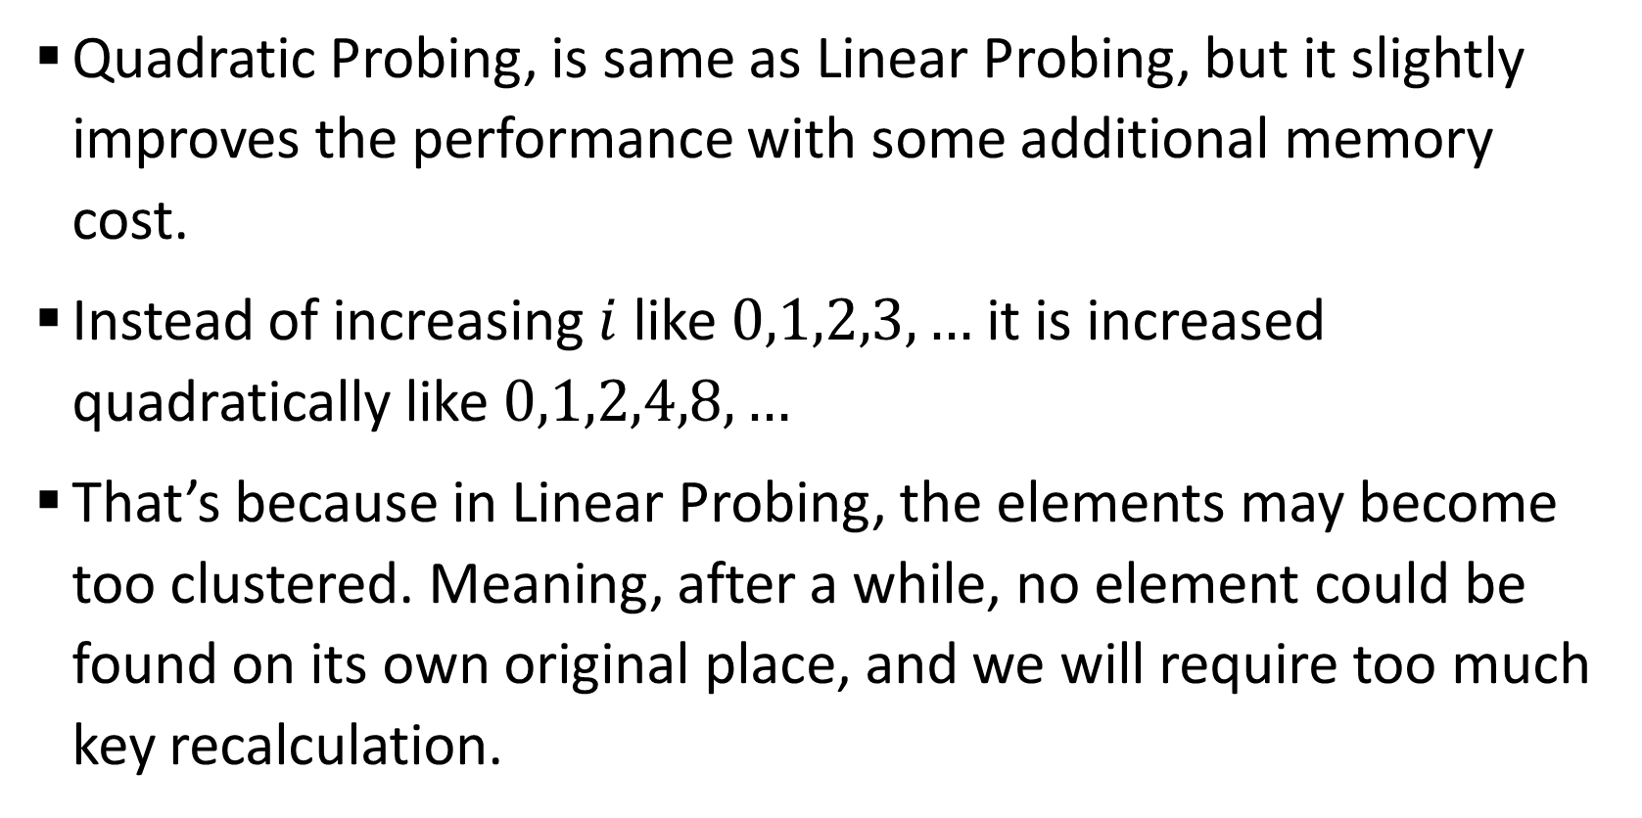
Sample 2
Handling Collisions
Quadratic Probing, is same as Linear Probing, but it slightly improves the performance with some additional memory cost.
Instead of increasing $i$ like $0,1,2,3,…$ it is increased quadratically like $0,1,2,4,8,…$
That’s because in Linear Probing, the elements may become too clustered. Meaning, after a while, no element could be found on its own original place, and we will require too much key recalculation.
0
5
1
1
2
2
3
3
4
8

Slide 28
Sample 2
Assignment 4
Your objective is to Heapify the given Binary Tree. Since this topic is not found in your textbook, you can learn about this algorithm from anywhere. However, my recommendation would be to go to: https://www.youtube.com/@abdul_bari and watch the Lecture “2.6.3”.
4967
5051
4669
5019
5187
5144
5139
3826
4901
4910
4930
1864
3045
5073
4946

Slide 29
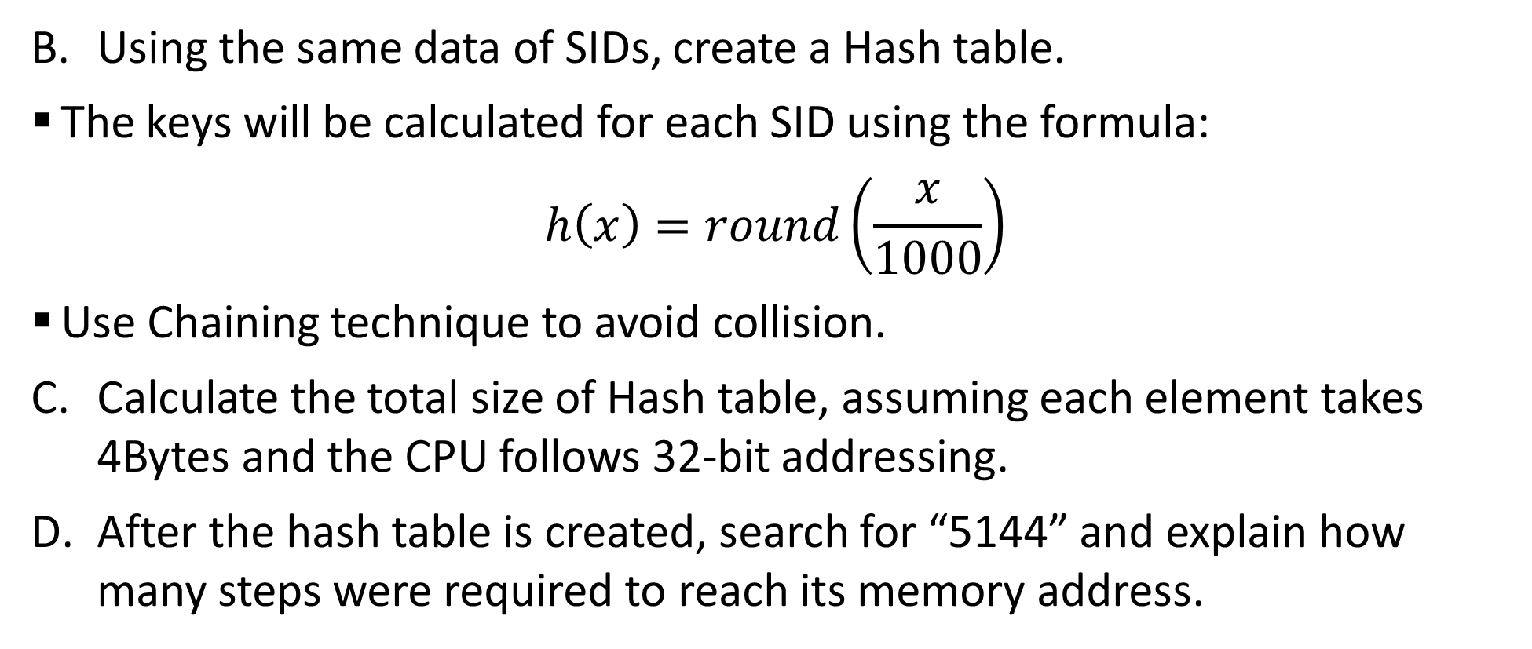
Sample 2
Assignment 4
Using the same data of SIDs, create a Hash table.
The keys will be calculated for each SID using the formula:
$$h\left(x\right)=round\left(\frac{x}{1000}\right)$$
Use Chaining technique to avoid collision.
Calculate the total size of Hash table, assuming each element takes 4Bytes and the CPU follows 32-bit addressing.
After the hash table is created, search for “5144” and explain how many steps were required to reach its memory address.

Slide 30



THANK YOU
Owais Hussain
+92 345-3174270
owais.hussain@kiet.edu.pk
https://www.researchgate.net/profile/Owais-Hussain-3

